Slide 1
Integrated Science Assessment Model (ISAM) (TRENDY)
CMIP6 Working group
2021.07.06
Rong Li

Slide 2
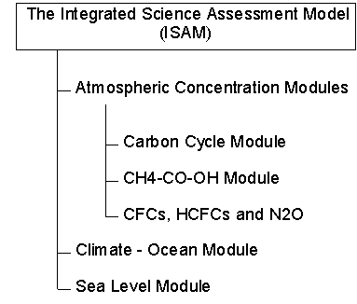
1. Model name: Integrated Science Assessment Model (ISAM)
2. Lead PI or contact person and her/his affiliation. Atul K. Jain University of Illinois at Urbana-Champaign, Urbana, Illinois, USA jain1@illinois.edu
http://climate.atmos.uiuc.edu/isam2/descript.html#atm

Slide 3
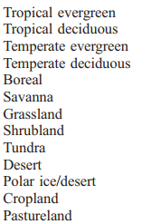
3. Static or dynamic vegetation: static
4. Number of plant functional types: 18
5 types of primary forests classified by ecozone; their corresponding “secondary forests,” ; 5 types of nonforested vegetation; bareland, cropland, and pastureland.
5. What disturbances are simulated ? Land use change can be simulated, no fire
PFT:
Primary and secondary forests
Jain et al, 2005,
Meiyappan et al, 2015

Slide 4
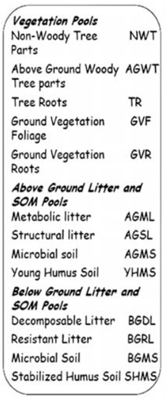
6. Number of pools
Total: 13
Vegetation pools: 5
Above-ground litter and SOM:4
Below-ground litter and SOM:4
Yang et al, 2009

Slide 5
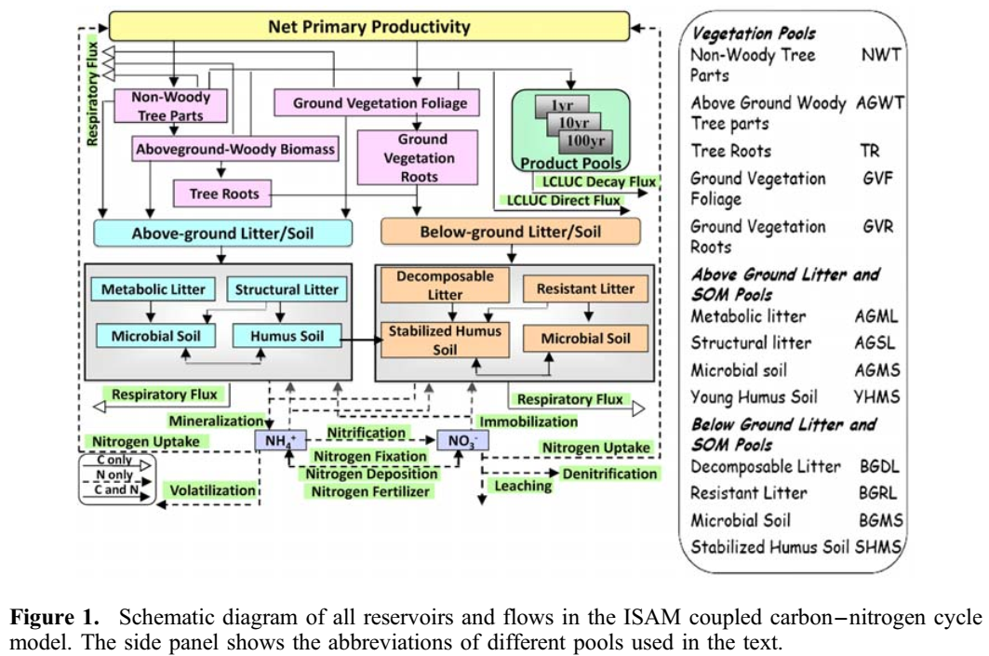
How are pools connected? (i.e., carbon flow diagram)
Yang et al, 2009

Slide 6
8. Outputs for CMIP6 or TRENDY
Only for TRENDY
TRENDY output:
http://dgvm.ceh.ac.uk/files/Trendy_ListofVariables_Nov2011.pdf
https://sites.exeter.ac.uk/trendy/protocol/

